Slide 1
Work schedule.bat
ELEBC 2023 Jessy

Slide 2
Outline of bat
.bat | Function | When to Work
01 Amenity | Input “radius”, “lat”, “lng” to OpenStreetMap API to get the amenities around the specific location. | Not scheduling now.
02 read_data_of_youbike | Use API to get the Youbike2.0_data from Taipei city in every 15 mins. E.g. “15min_Youbike_cleaned.xlsx” | Every 15 mins
03 daily_bemp_merged | Combine the “15min_Youbike_data excels” to “merged data.xlsx” by DAY. | Every day 00:05
04 ev | Compute the former day EV by “merged data.xlsx” | Every day 00:10
05 ac_pv | Compute everyday AC & PV by “0015 Youbike_cleaned.xlsx” | Every day 00:20
06 evm | Compute former day SV, CV, SPI, CPI based on 04&05. The columns of EVM file are EV, AC, PV, SV, CV, SPI, CPI. | Every day 00:35
07 | Update the EVM file in the former day to Google sheet connected to the Power BI. | Every day 00:40

Slide 3
Run02.bat
Use API to get the Youbike2.0_data from Taipei city in every 15 mins
Output file example: 2024-04-24 1115_Youbike_cleaned.xlsx

Slide 4

Run02.bat(0)

Slide 5
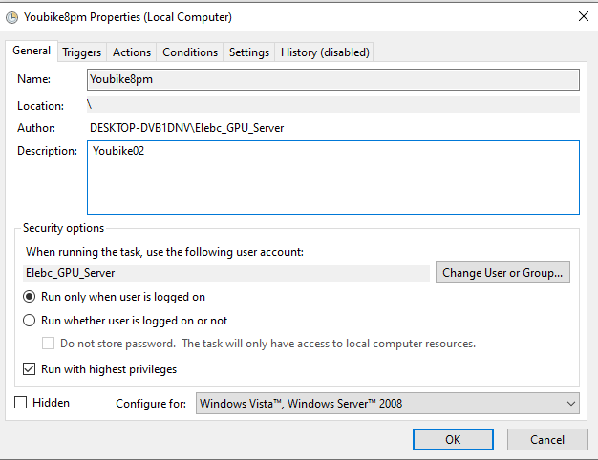
Run02.bat (1)

Slide 6
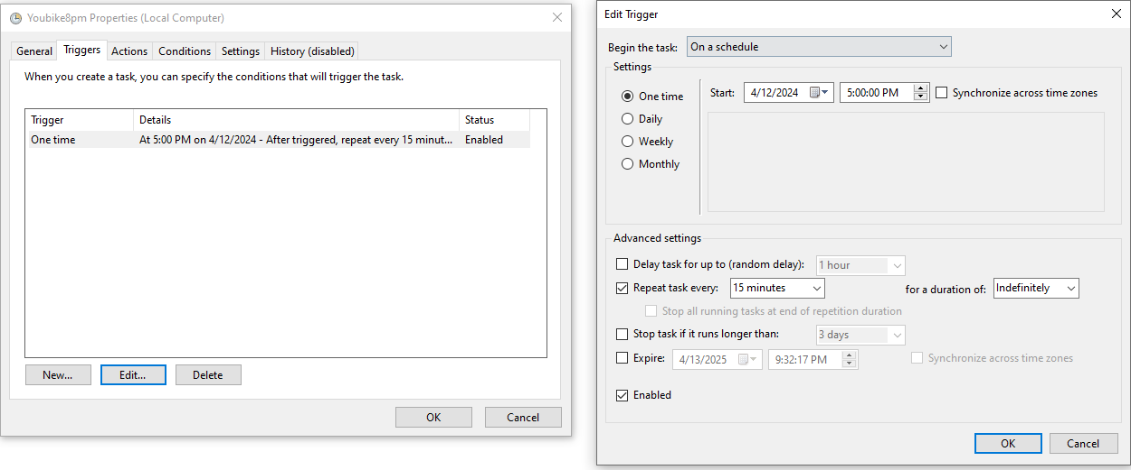
Run02.bat (2)

Slide 7
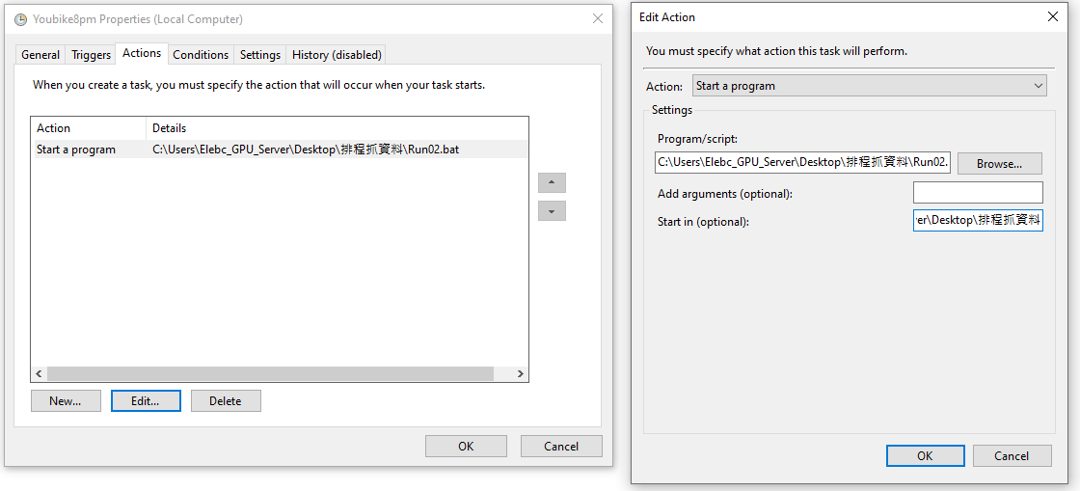
Run02.bat (3)
Start in C:\Users\Elebc_GPU_Server\Desktop\排程抓資料

Slide 8
Run03.bat
Combine the Youbike_15mins_data excels to merged data by DAY.
Select column [“bemp”].
Output file example 2024-04-23 merged_data.xlsx

Slide 9

Run03.bat (0)

Slide 10
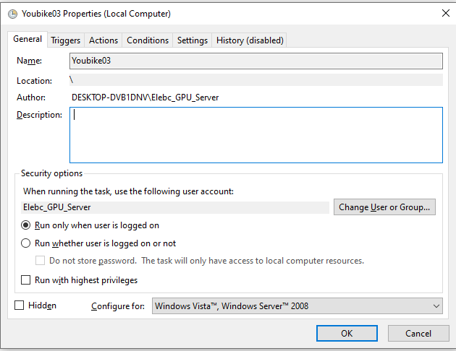
Run03.bat (1)

Slide 11
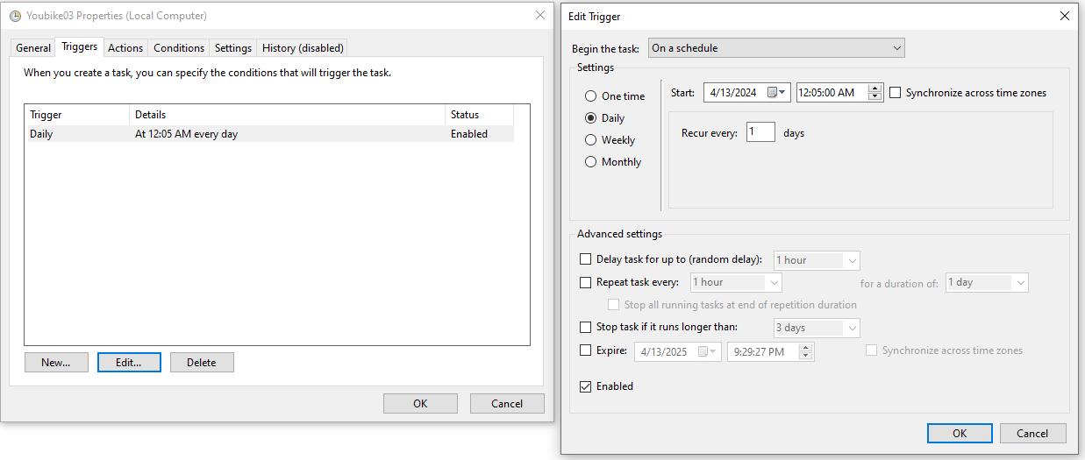
Run03.bat (2)

Slide 12
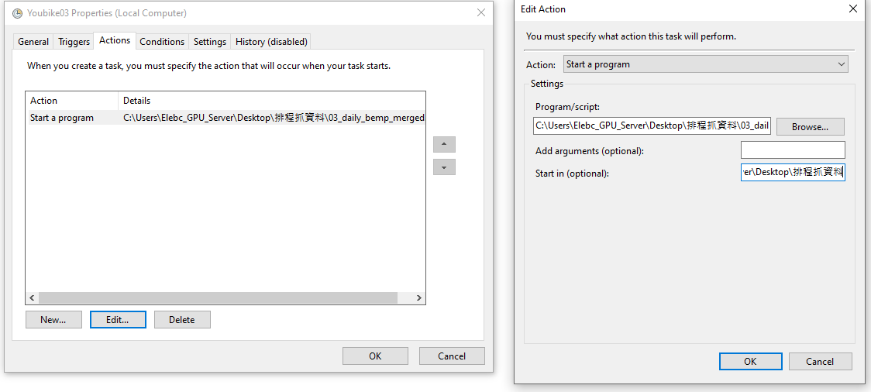
Run03.bat (3)
Start in: C:\Users\Elebc_GPU_Server\Desktop\排程抓資料

Slide 13
Run04.bat
Compute the former day’ EV by “merged data.xlsx”
Output file example 2024-04-23 EV.xlsx

Slide 14

Run04.bat (0)

Slide 15
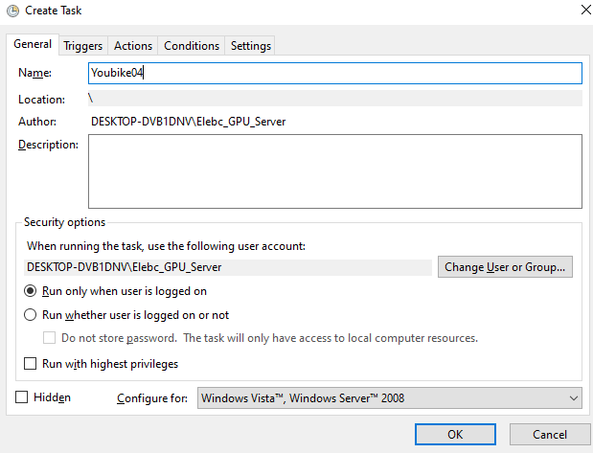
Run04.bat (1)

Slide 16
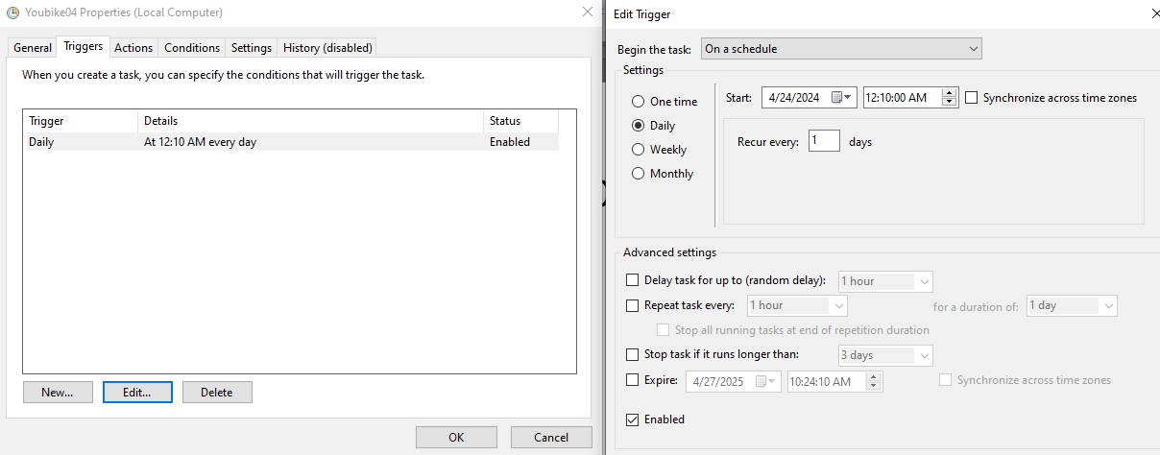
Run04.bat (2)

Slide 17
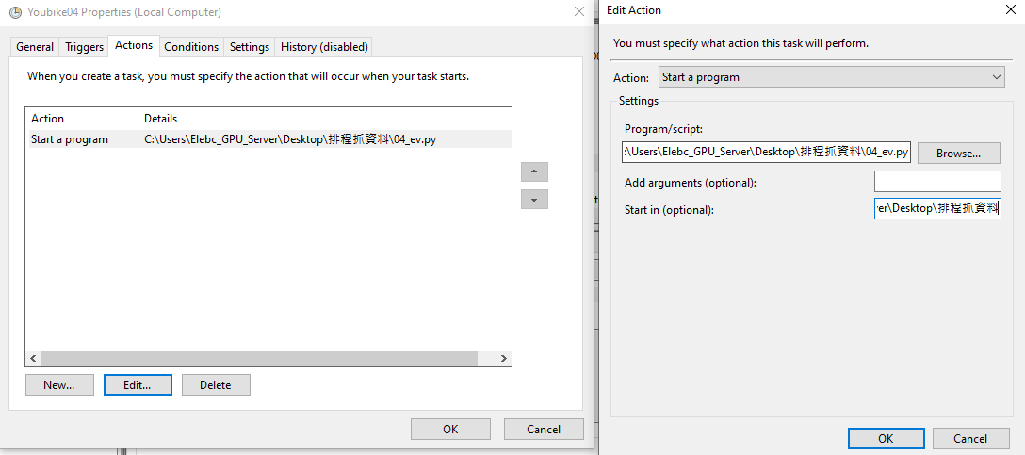
Run04.bat (3)

Slide 18

Run05.bat
To be based data with ['sno','sna',"sarea","ar","lat","lng",'tot','infoDate']+[“AC”,”PV]
Compute the everyday AC & PV by “0015 Youbike_cleaned.xlsx”
Output file example 2024-04-23 AC_PV.xlsx

Slide 19

Run05.bat(0)

Slide 20
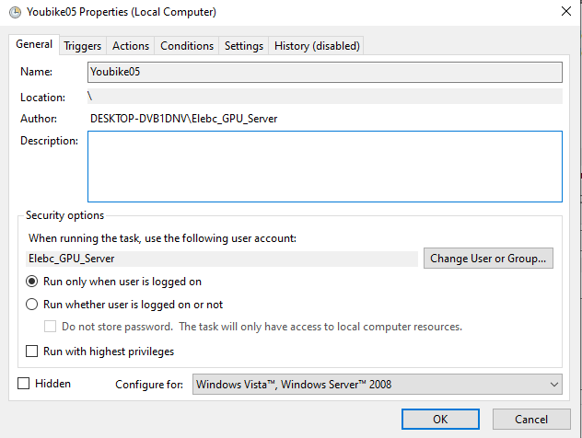
Run05.bat(1)

Slide 21
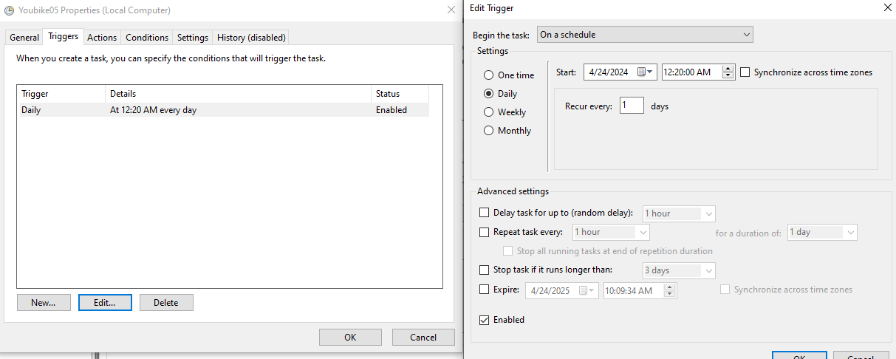
Run05.bat(2)

Slide 22
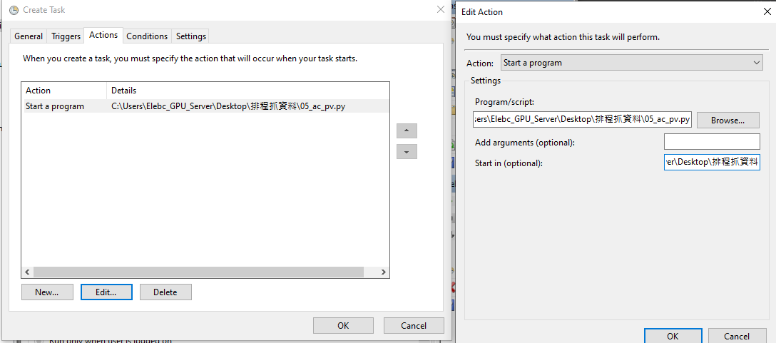
Run05.bat(3)

Slide 23
Run06.bat
Compute former day SV, CV, SPI, CPI based on 04&05. The columns of EVM file are EV, AC, PV, SV, CV, SPI, CPI.
new_column_order = [ 'sno', 'sna', 'sarea', 'ar', 'lat', 'lng', 'tot', 'infoDate', 'INPUT_ride', 'OUTPUT_ride',"AC","PV","EV","CV","SV","CPI","SPI",] + [f'{hour:02d}{minute:02d}' for hour in range(24) for minute in (0, 15, 30, 45)]

Slide 24

Run06.bat(0)

Slide 25
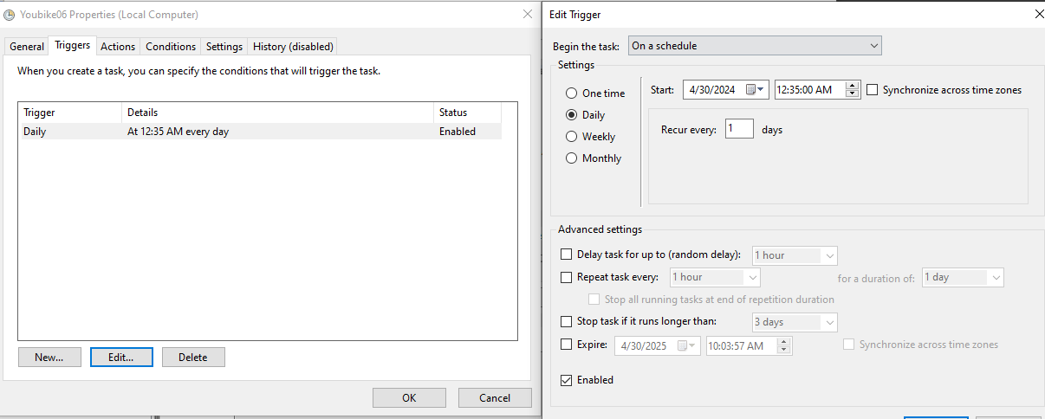
Run06.bat(1)

Slide 26
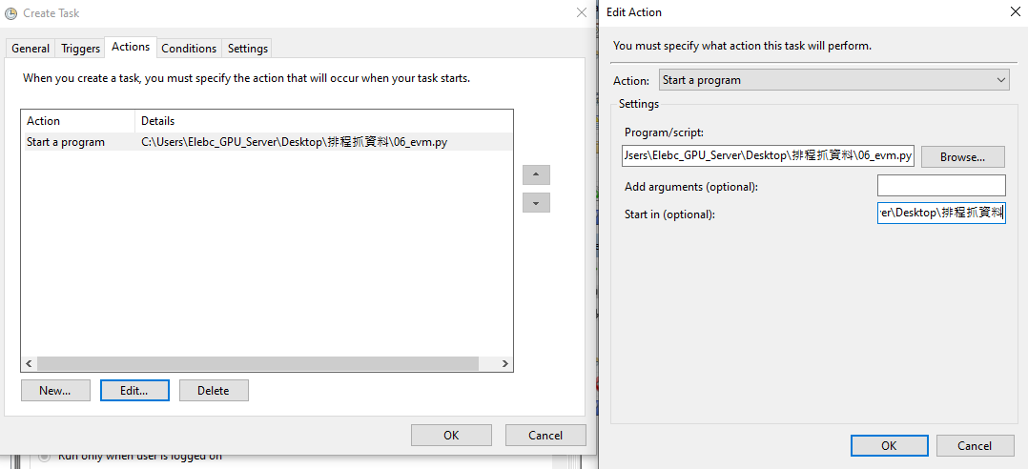
Run06.bat(2)

Slide 27
Run07.bat

Slide 28
Some weird ERRORs, we lossed the data…
2024/04/16
2024/04/17
2024/04/23站點資料消失(可能在維護)
2024/04/24

